Slide 1



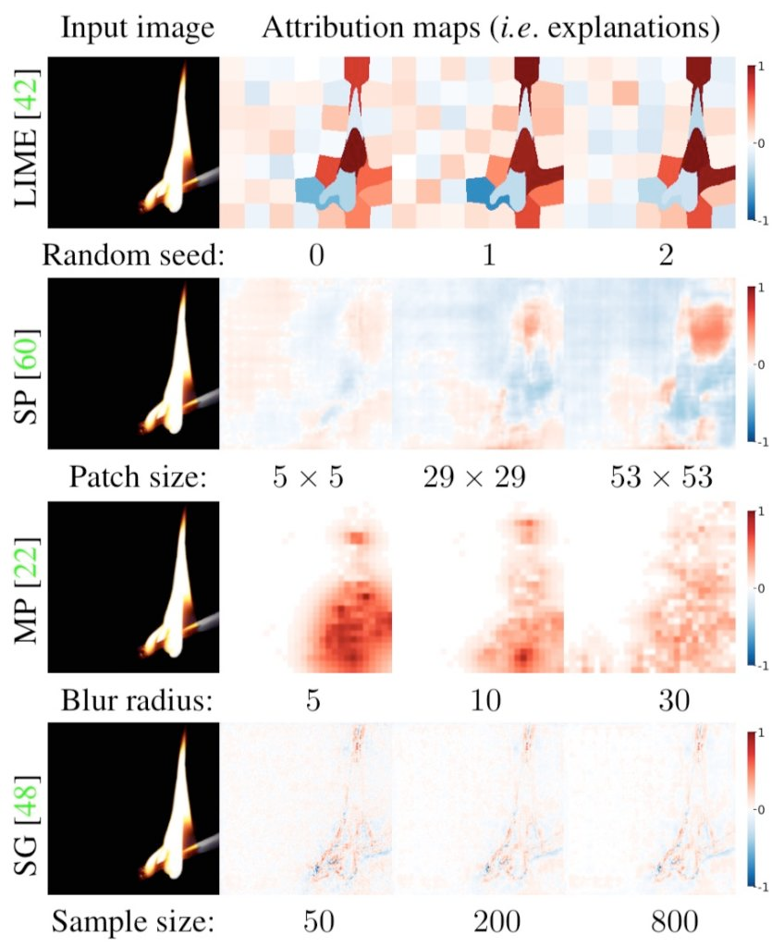
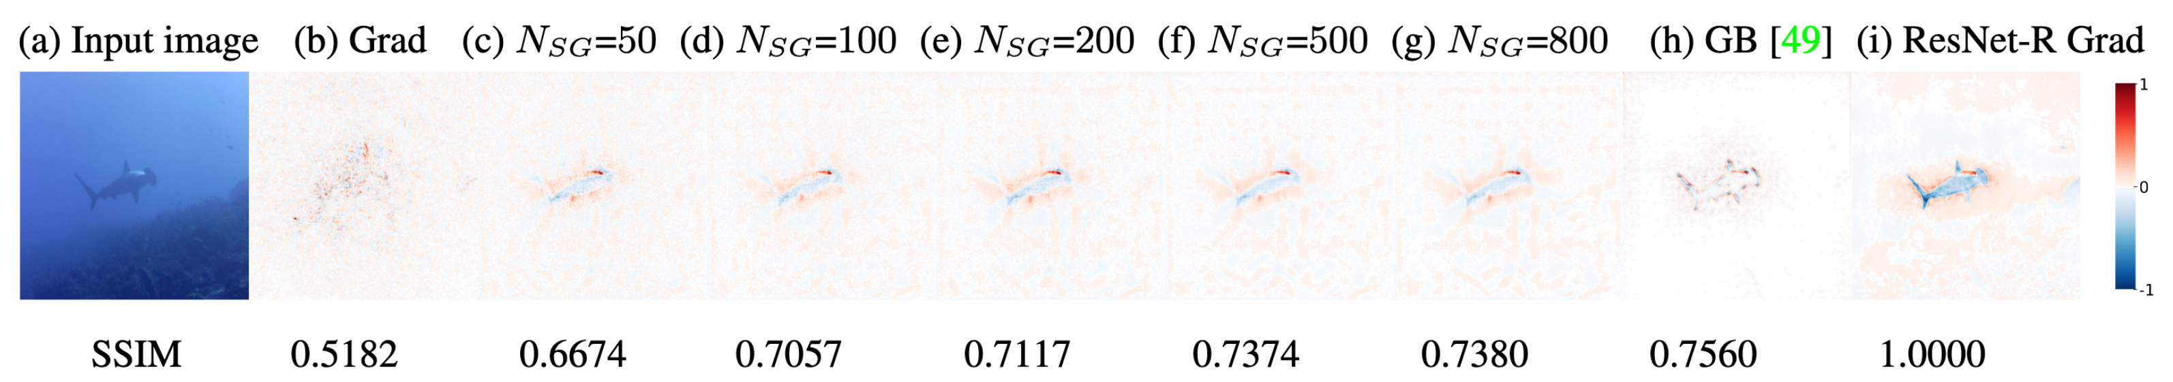
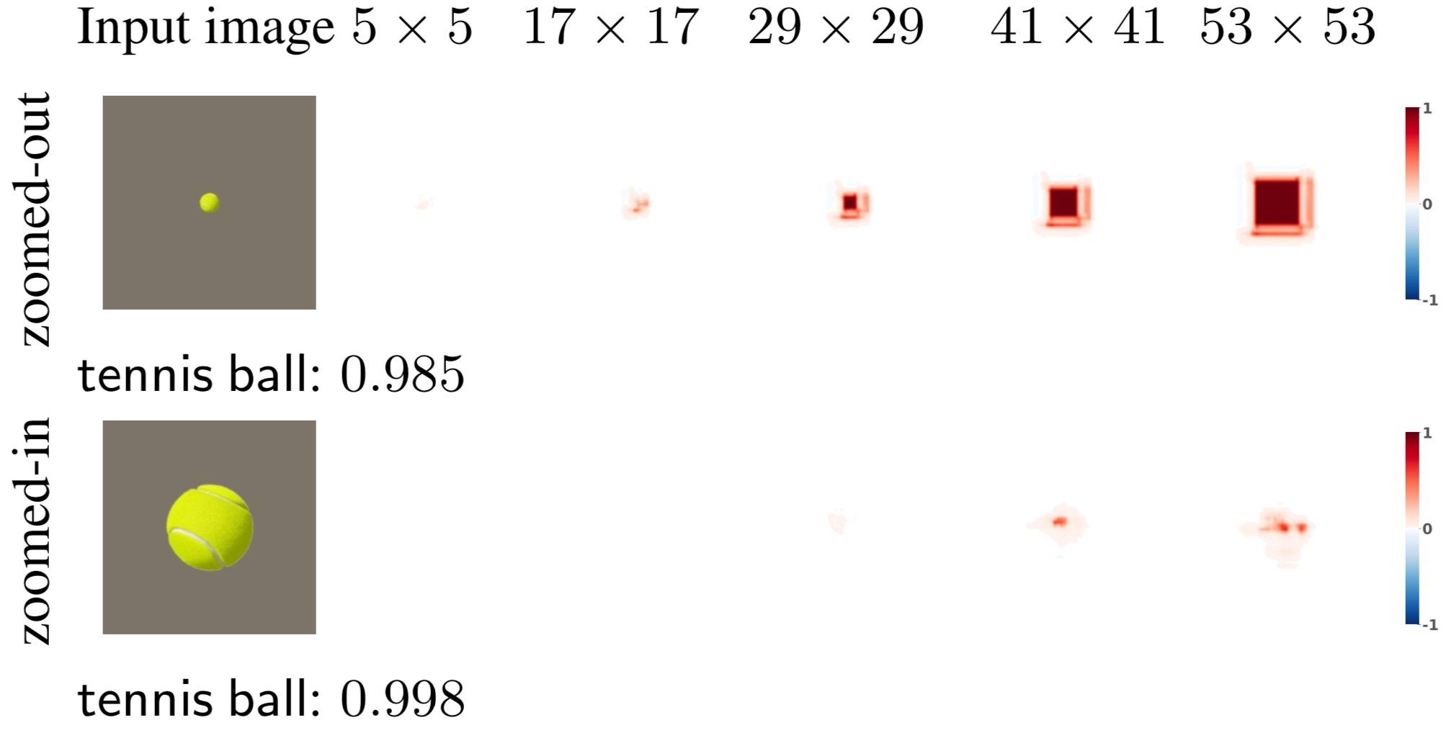
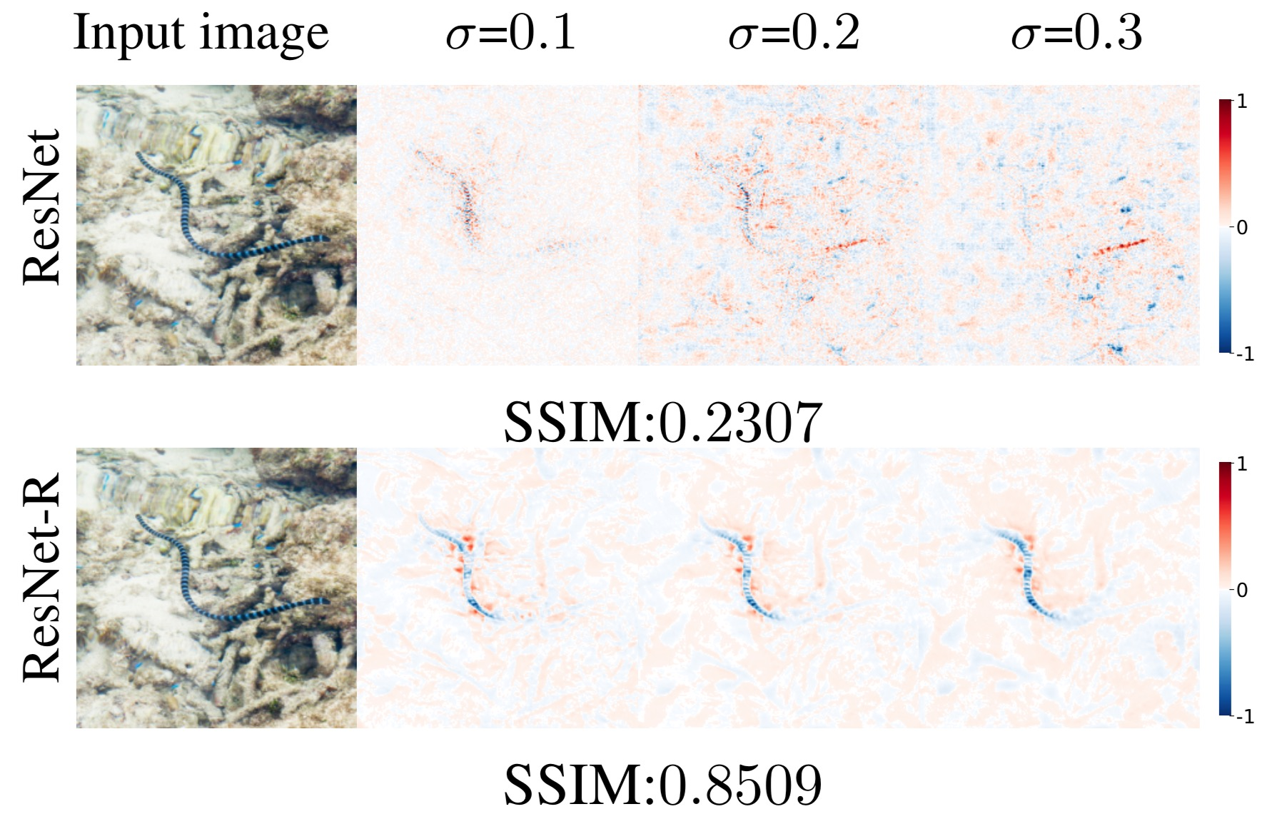
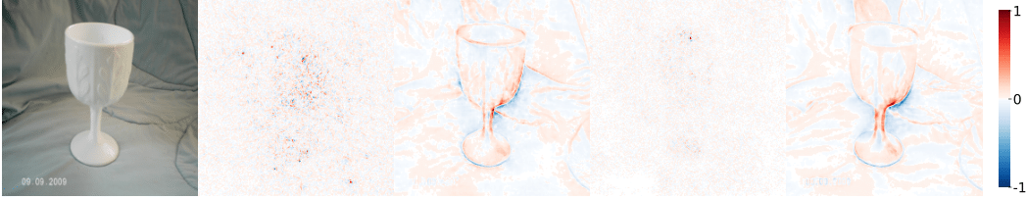
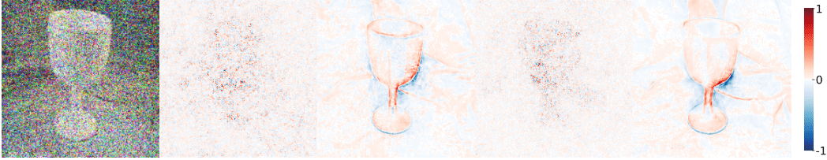
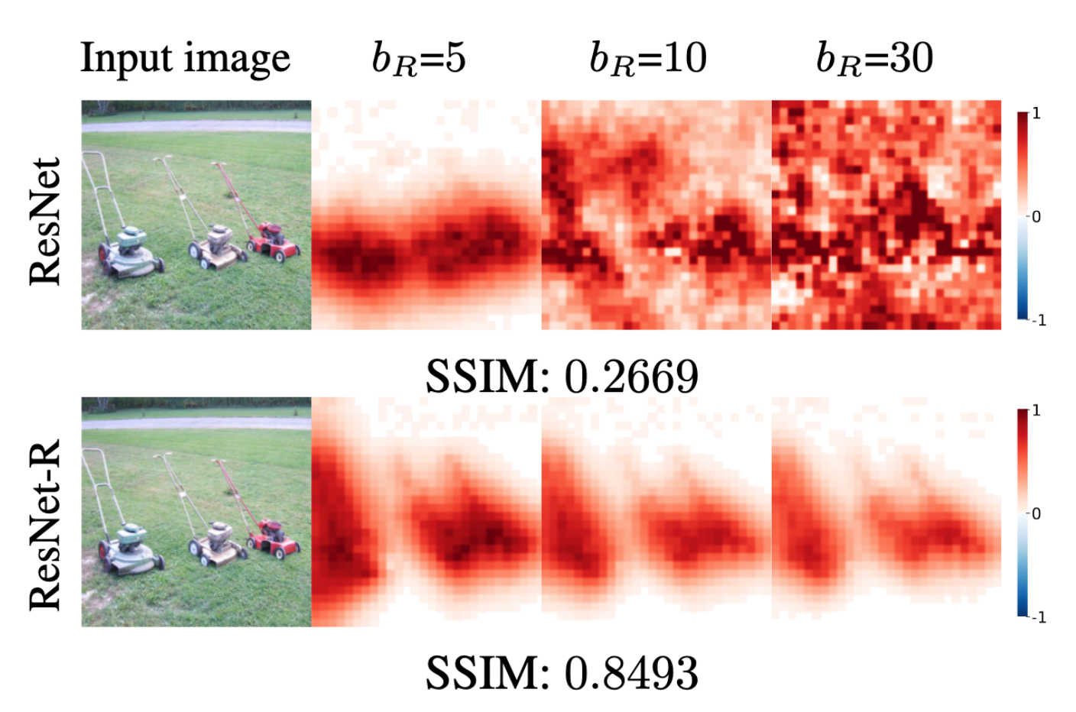
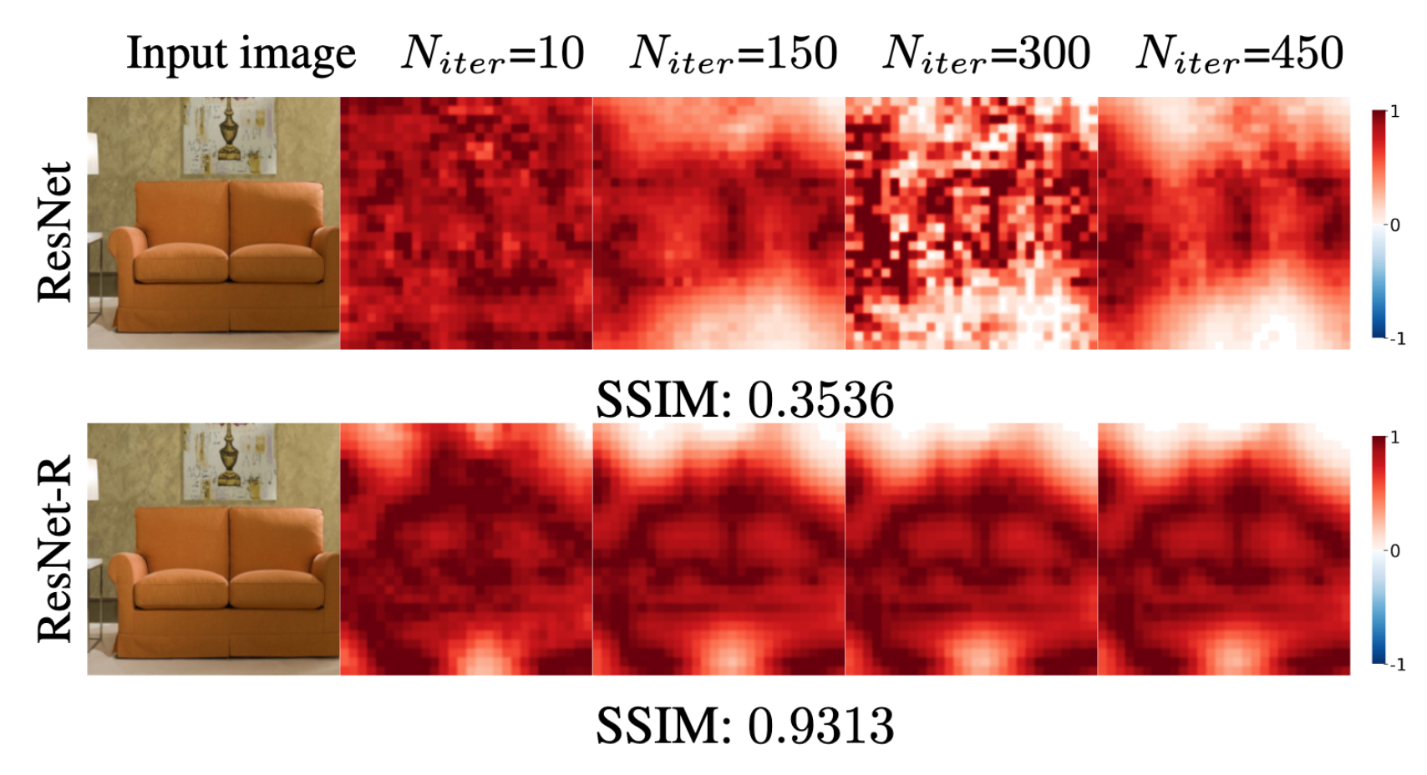
SAM: The Sensitivity of Attribution Methods to Hyperparameters
Naman Bansal* (Auburn U), Chirag Agarwal* (U Illinois at Chicago), Anh Nguyen* (Auburn U)
* Equal contribution. Code and paper: http://anhnguyen.me/project/sam
Summary
Sensitivity of Accuracy Scores
Many attribution methods are highly sensitive to changes in their common hyperparameters.
This sensitivity also translates into variation in accuracy scores.
Compared to regular classifiers, explanations for robust classifiers are more invariant to input perturbations and more consistent when hyperparameter changes.
Vanilla gradient images can exhibit clear visible outlines of objects in the input image.
Smoothing / denoising explanations may mislead our interpretation of explanations.
E.g. SmoothGrad (SG) heatmaps of a ResNet become increasingly similar to the gradient of a completely different network (ResNet-R) as we increase the smoothing hyperparameter.
On average, SSIM similarity increases ~1.4×.
SSIM
Localization Error (WSL)
Deletion
Variation in heatmaps (SSIM) also translates into the variation in the accuracy scores (WSL and Deletion).
WSL scores are highly sensitive with average stds being ~0.51× and ~0.31× of the mean accuracy scores for both regular and robust models.
Across all four tested hyperparameters, the correctness of explanations for robust models is on average 2.4× less variable than regular models
Even a small pixel-wise variation in explanation (~1 mean SSIM for SP-S) may lead to large variation in accuracy scores (stds are ~10% of mean statistics in SP-S)
Sensitivity of Attribution Maps
classifier: matchstick 0.535
Experiments
Input
GoogLeNet
GoogLeNet-R
ResNet
ResNet-R
Clean
Sliding-Patch (SP) heatmaps are, by design, sensitive to patch sizes.
SG heatmaps for ResNet-R are more robust.
Noisy
Localization Error (WSL)
Deletion
Insertion
SSIM
0.2163
0.7372
0.4740
0.8067
Some hyperparameters leads to higher variation in explanation accuracy scores as opposed to others.
In LIME, the variation in the number of super-pixels leads to higher sensitivity as compared to the random seed (130.5× higher std).
In MP, the std of Insertion scores is 74× and 16.6× higher for variation in number of iteration and blur radius respectively as compared to changing the random seed.
Changing the random seed in LIME vs MP (two different methods) interestingly causes a similar variation in all three-accuracy metrics.
The vanilla gradients of robust classifiers (GoogLeNet-R, ResNet-R) consistently exhibit visible object outlines, which is in stark contrast to the notoriously noisy gradient saliency maps of regular classifiers (GoogLeNet, ResNet).
The gradient explanations of robust classifiers are significantly more invariant to a large amount of random noise added to the input image.
Meaningful Perturbation (MP) heatmaps for ResNet vary dramatically. In contrast, MP heatmaps for robust models (ResNet-R) are ~1.4× more consistent under SSIM metric and converge faster (10 steps vs. 300 default).

